Slide 1
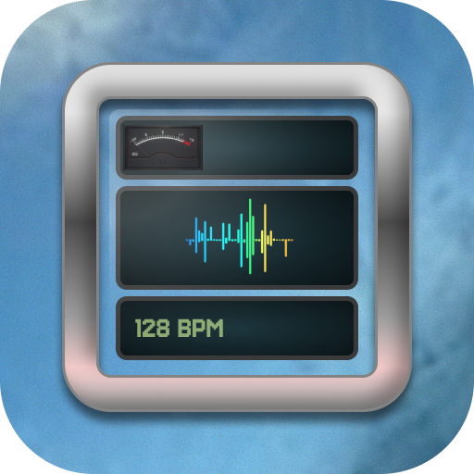
MaxiMeter
By Cybersonus

Slide 2
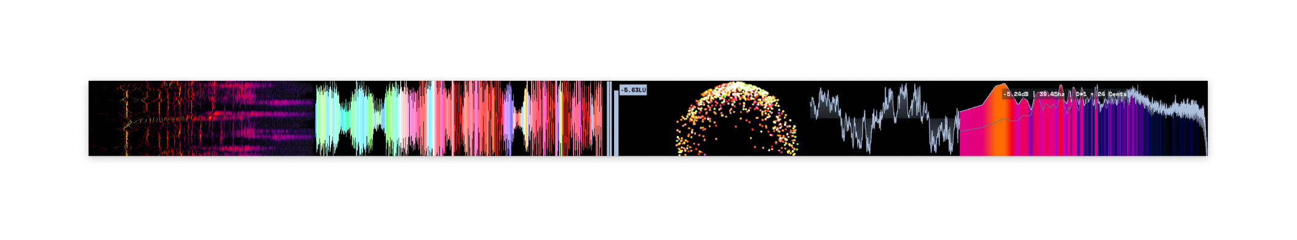
The idea: MiniMeters

Slide 3
The idea: MiniMeters
What if: We can place and customize meters on a grid,
While allowing custom GLSL + python-based audio meters?

Slide 4
The idea: MiniMeters
What if: We can place and customize meters on a grid,
While allowing custom GLSL + python-based audio meters?
What if: It’s entirely free and customizable,
Using Winamp wsz skins?

Slide 5
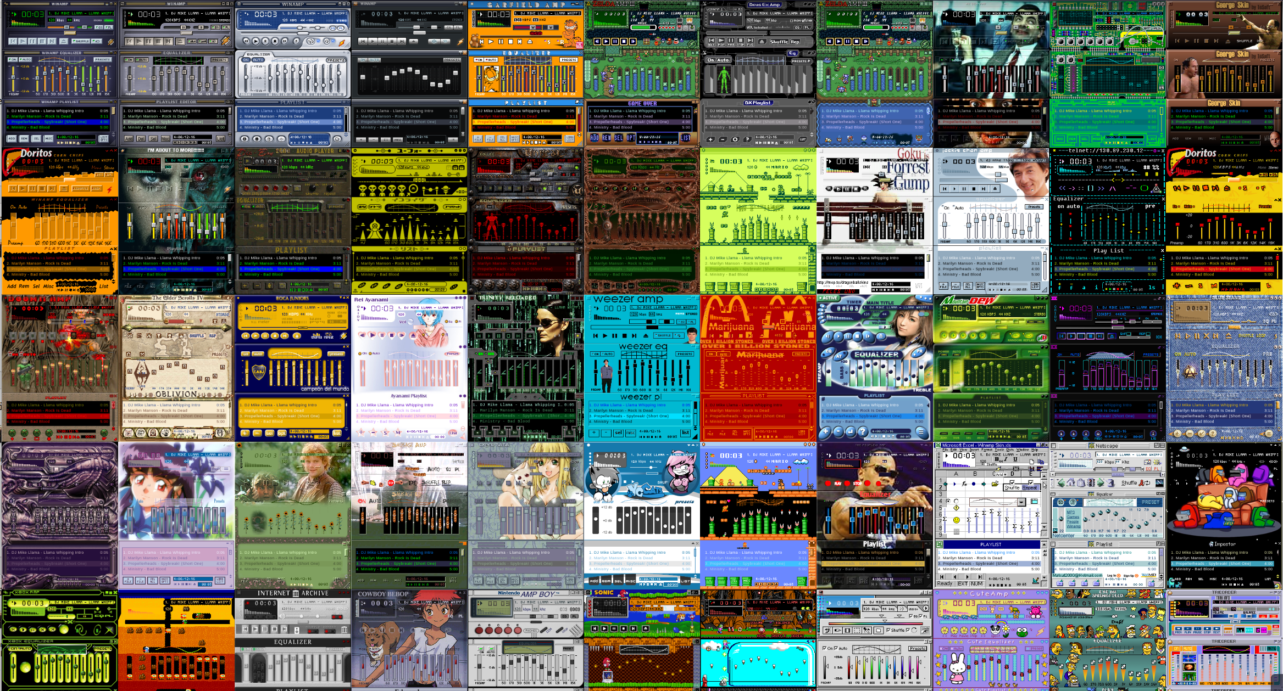

Slide 6
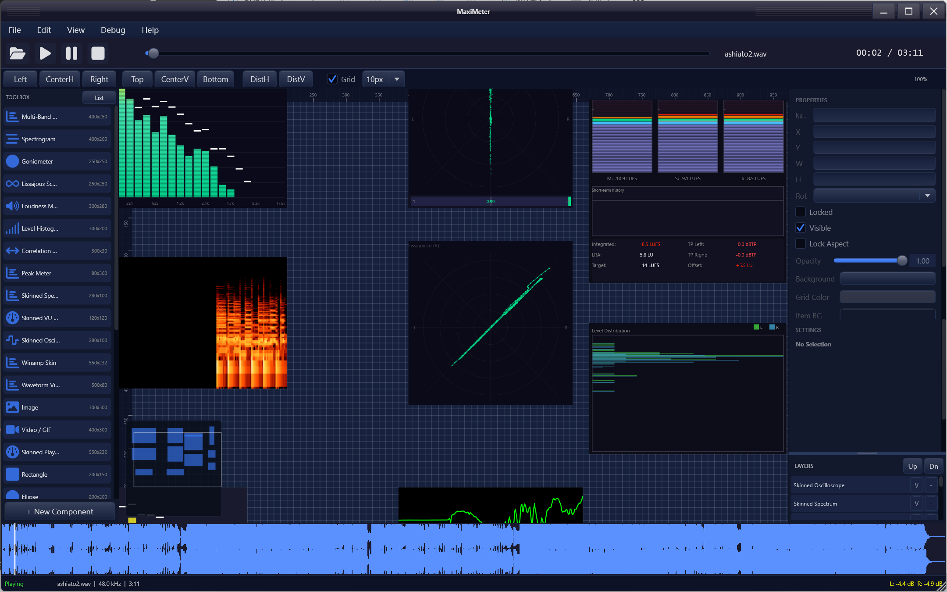

Slide 7
Player

Slide 8
Component
Toolbox

Slide 9
Properties
Settings
Layers…

Slide 10
Viewport

Slide 11
Waveform Visualizer

